Slide 1

Verb Sense Disambiguation using Neural Network
-Pranay Jain (15-1-4-035)
-Pramod Singh Yadav(15-1-4-101)
Project Guided By-
Dr. Koushik Guha
Assistant Professor
Dept. of Electronics and Communication Engg.
NIT Silchar
Notes:
Pramod

Slide 2
Contents
Introduction
Aim of the Project
Process Flow
Latent Semantic Analysis
Term Frequency-Inverse Document Frequency
Cosine similarity of noun and verb with surrounding terms.
Pearson and Spearman Coefficient correlation.
References

Slide 3
Introduction
Many words in Indian languages as well as Foreign languages have different meanings according to the context in which they are being used.
Ambiguity of Noun and Verb are most common and can be removed by observing their surrounding terms in the context.
Dictionaries, while giving the meaning of any verb or noun, also explains the context in which it is being used.

Slide 4
Aim of the Project
The human brain efficiently differentiates between meaning of the verb by associating it with noun and its surrounding terms in the sentence.
We aim to develop a program to find out exact sense of a ambiguous verb used in a context.
We aim to develop a database which will provide a list of possible surrounding terms which can be used with a verb in a particular context.

Slide 5
Process Flow of the Project

Slide 6
Dataset
Bag of Words
TF-IDF
Separate nouns, verbs and surrounding terms
Cosine Similarity of verb with surrounding terms
Cosine Similarity of noun with surrounding terms
Cosine Similarity of verbs with nouns
Pearson and Spearman Correlation

Slide 7
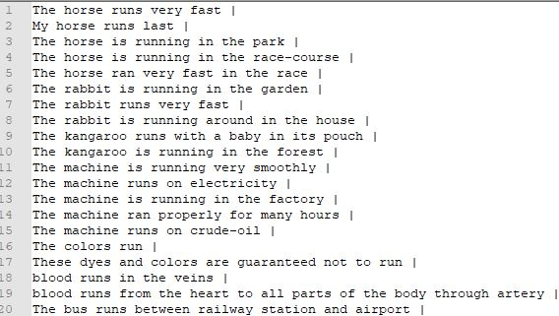
Sample Dataset

Slide 8
LATENT SEMANTIC ANALYSIS
LSA is a mathematical technique that generates a high-dimensional semantic space from the analysis of a large corpus of written text.
The raw data for LSA are meaningful passages and the set of words each contains.
A matrix is constructed whose columns are words and whose rows are documents.
The cells of the matrix are the frequencies with which each word occurred in each document.
This frequency is called Term Frequency(tf).
From this matrix, we calculate normalized term frequency.

Slide 9
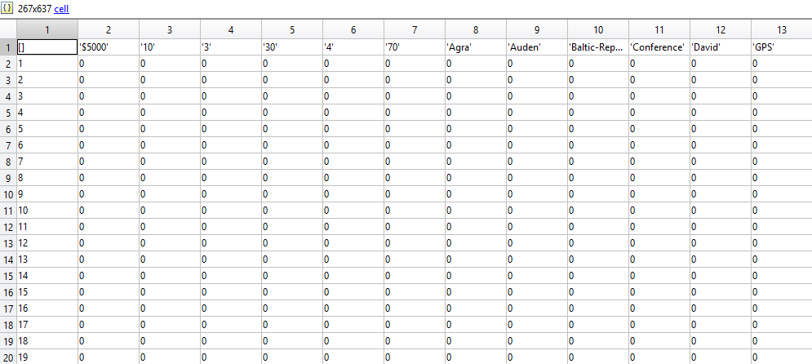
An example of the LSA is as shown in the following figure.
For each column in the matrix a idf value is calculated using the formula-
IDF(word)= 1+log_{e}(total no. of documents/no. of documents with the term in it)
This IDF value for each word is then multiplied with the normalized term frequency.
After that we would
seperate noun and
verbs from other surr-
-ounding terms.

Slide 10
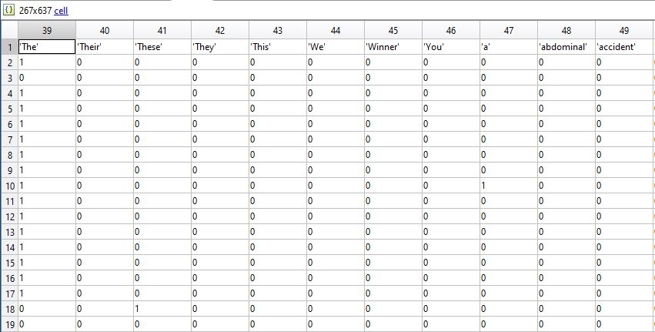
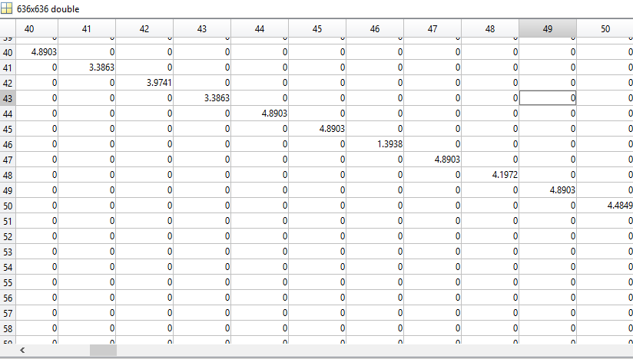
Term Frequency and Inverse Document Frequency Table

Slide 11
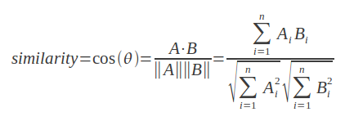
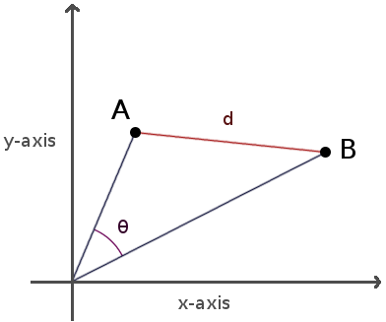
Cosine Similarity
The cosine similarity is a method of obtaining the closeness of two words by taking the dot product of the words by using the formula-

Slide 12
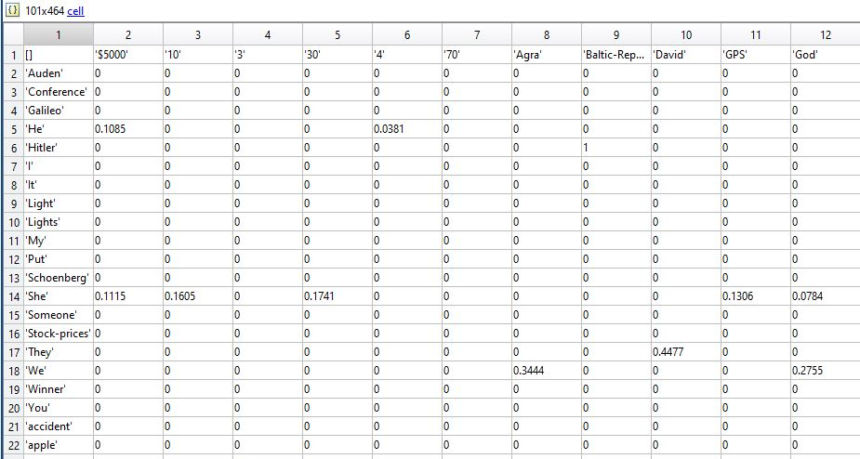
Cosine Similarity Values of Dataset

Slide 13
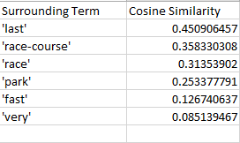
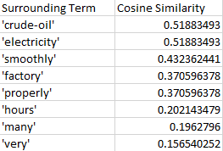
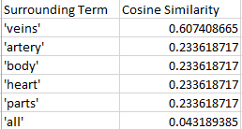
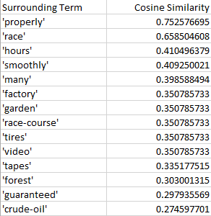
Cosine similarity of Noun and Verb with surrounding terms
Fig. 1 highest surrounding terms of noun Horse
Fig.2 Highest surrounding terms of noun Machine
Fig. 3 Highest surrounding terms of noun Blood
Fig. 4 Highest surrounding terms of verb Run

Slide 14



Cosine Similarity between Noun and Verb
Fig.1 Cosine similarity between Horse and run
Fig. 2 Cosine similarity between Machine and run
Fig. 3 Cosine similarity between Blood and run

Slide 15
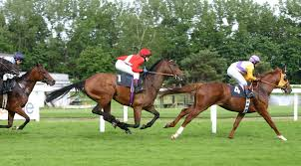
From cosine similarity value
Find out surrounding terms of polysemous verb.
Find out sense of polysemous verb with respect to surrounding terms specially noun.
Example1: The horse runs in the race.
cos (horse, race)=0.3135
cos (runs, race)=0.6585
cos( horse, runs)=0.2152
cos( horse, race),cos( runs, race) horse runs
Where horse and race non ambiguous term.
If horse and runs are used together then sense of runs is ‘moving fast’ provided horse and race will appear together in the same context.

Slide 16
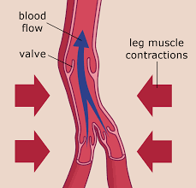
Example2: Blood runs in the veins.
cos( blood, runs)=0.0247
cos( blood, veins)=0.6074
cos( runs, veins)=0.2746
Where blood and veins are non ambiguous term.
runs and blood together can infer the sense of run is ‘flowing’ provided blood and veins appears together in same context.

Slide 17
Correlation and Coefficient of Correlation
Correlation is a statistical technique that can show whether and how strongly pairs of random variables are related.
The correlation coefficient is a statistical measure that calculates the strength of the relationship between the relative movements of two variables.
The values range between -1.0 and 1.0.

Slide 18
Pearson Correlation
The Pearson correlation coefficient is a measure of the strength of the linear relationship between two variables.
The value of pearson correlation coefficient tells us about the relation between two variables as follows -
1 for strictly positive linear relationship
-1 for strictly negative relationship
0 for no linear relationship.

Slide 19
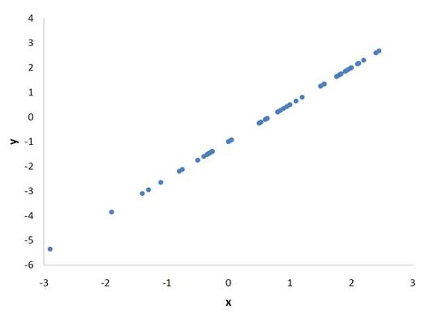
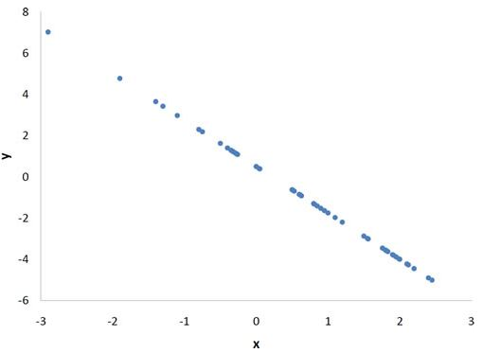
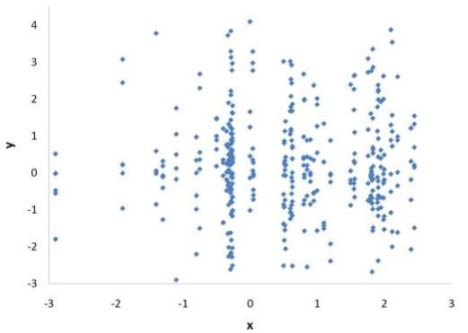
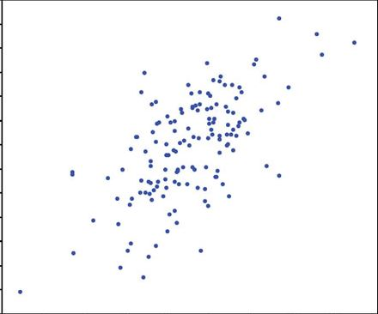
Fig. 1 r_{p}=1 Perfect positive linear relationship
Fig. 2 r_{p}=-1 Perfect negative linear relationship
Fig. 3 r_{p}=0 no linear relationship
Fig. 4 r_{p}=0.63 strong positive linear relationship

Slide 20
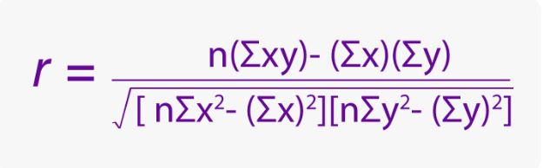
Pearson Correlation Coefficient
The formula for pearson correlation coefficient is
dwsdsds
where n= total no. of data entries
and x and y are the data entries in the respective columns.

Slide 21
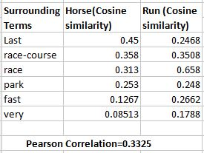
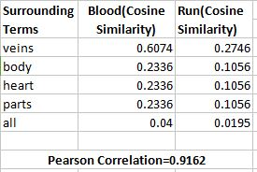
Pearson correlation Coefficient Values for verb RUN

Slide 22
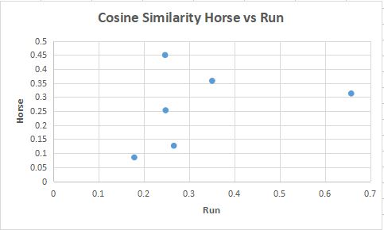
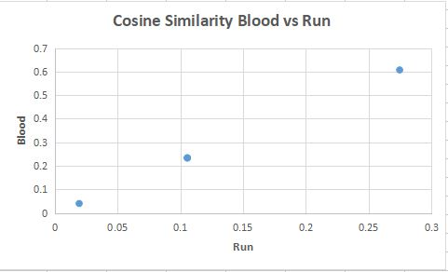
Scatter Plots

Slide 23
Spearman Correlation
Spearman’s correlation coefficient is a statistical measure of the strength of a monotonic relationship between paired data.
The value of spearman correlation coefficient tells us about the relation between two variables as ;
1 for perfect positive monotonic relationship
-1 for perfect negative monotonic relationship
0 for no correlation .

Slide 24
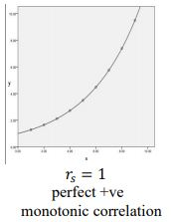
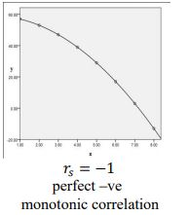
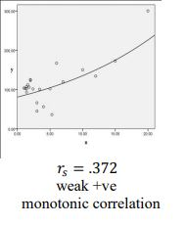
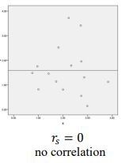

Slide 25

Spearman Correlation Coefficient
The formula for spearman correlation coefficient is
where n= total no. of data entry pairs.
d_{i} is the difference of respective rank of columns for the i ^{th} element.

Slide 26
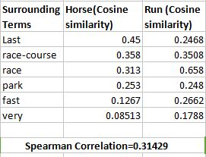
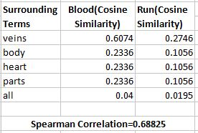
Spearman Correlation Coefficient values
For Verb Run

Slide 27
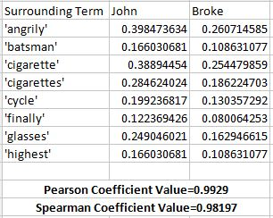
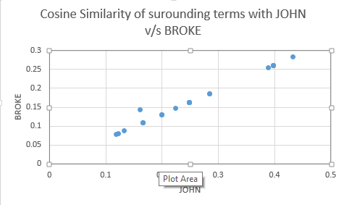
Pearson and Spearman coefficient
For Verb Broke

Slide 28
References
Dataset- https://wordnet.princeton.edu/
https://janav.wordpress.com/2013/10/27/tf-idf-and-cosine-similarity/
Kintsch, W. (2001), ”Predication”, Cognitive Science, 25, 173-202.
B Kievit-Kylar, GKachergis, MNJones, ”Naturalistic Word-Concept Pair Learining with Semantic Spaces”, Cognitive Science,2013.
George A. Miller. Word net: A Lexical Database for English Communication, ACM, 38(11):39-41, 1995.
Roberto Navigli, ”Word sense disambiguation: A survey”. ACM Computing Surveys. 41(2), 2009.
Pal, A. R.,Saha, D. “Word sense disambiguation: A survey”. International Journal of Control Theory and Computer Modeling (IJCTCM) Vol.5, No.3, July 2015.

Slide 29
Thank You

